Slide 1
Texas Community Development Block Grant Program
Group A Documentation and Performance Report
Administrators Workshop
Notes:
Texas Community Development Block Grant Program Administrators Workshop
Group A Documentation and Performance Report

Slide 2
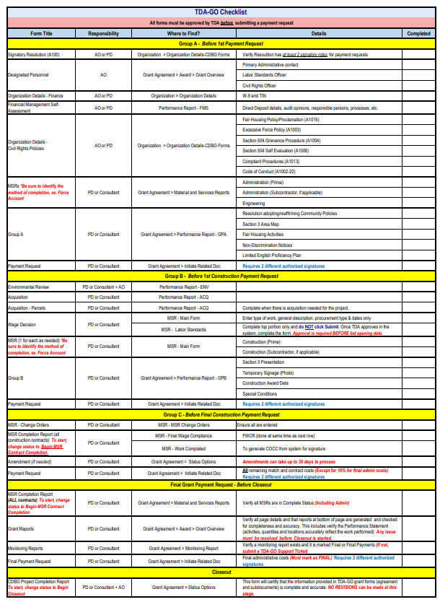
TDA GO! Checklist
Located on the TDA website on the Implementation Manual, Forms, and Appendices page.
Notes:
Because the list of Group A Documents is extensive, TDA recommends utilizing the TDA-Go Checklist.
The TDA-GO Checklist can be found under the section labeled “TDA-GO Reference Documents” of the CDBG implementation manual, forms, and appendices page on the TDA website.
TDA recommends its use as it shows what document is needed, who is responsible for the document, where to find it, and other important details.

Slide 3
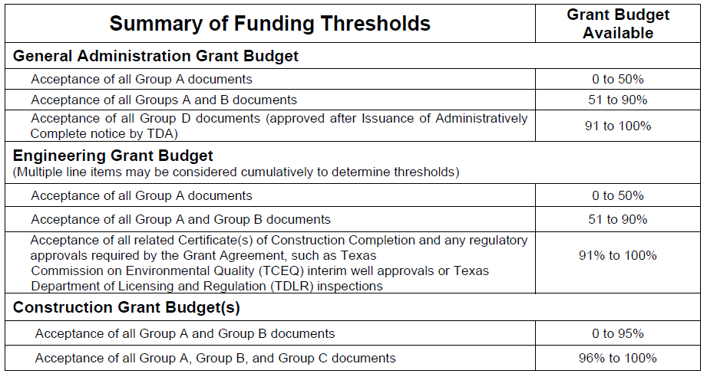
Thresholds
Notes:
No grant funds will be disbursed until all Group A documents have been accepted.
Once all Group A requirements have been approved by TDA staff, the Grant Recipient may request the following, as costs are actually incurred:
• Up to 50% of the administrative budget, and
• Up to 50% of the engineering budget.

Slide 4
Group A - Components
Documents and Information:
Organization Information
Grant Overview
Materials and Services Reports
Group A Performance Report
Notes:
The CDBG program requirements use several document groupings to implement certain thresholds.
This presentation will focus on the Organizational Information and the Grant Overview page.

Slide 5
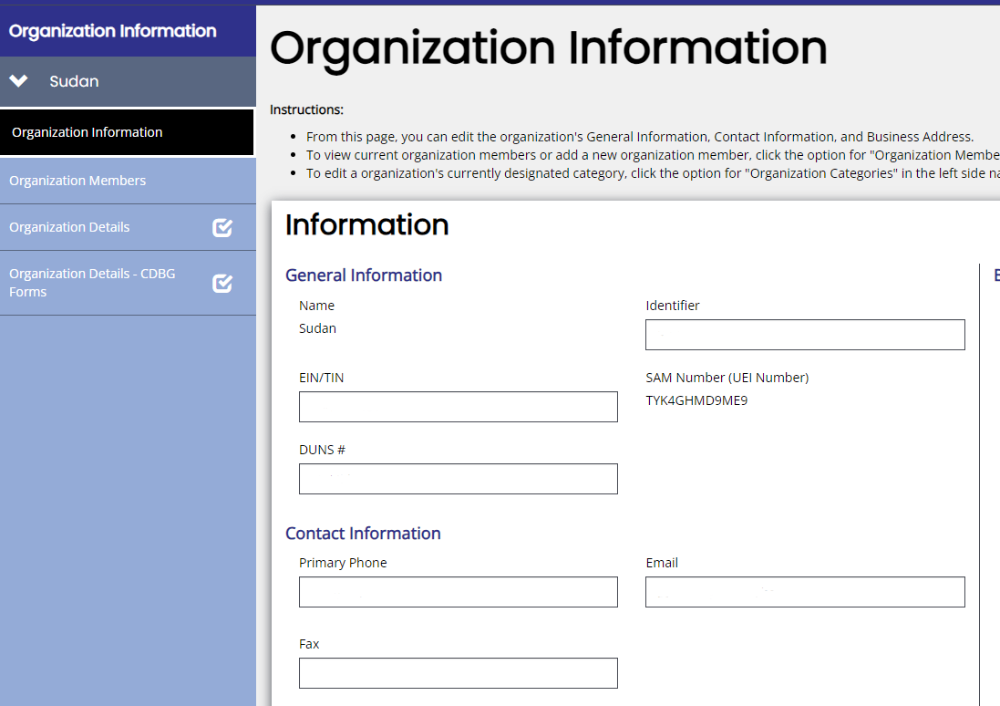
Group A - Organization Information
Notes:
Part of the Group A documentation is to provide general information about the organization. Because this information is particular to each Grant recipient, the Administrator will not be able to enter data on this page but can assist in guiding on where to find the required forms and who the contact person should be.
On the Organization Information page, the Grant Recipient will complete the following information:
The EIN/TIN
The SAM number
The DUNS number, and
Contact Information. We ask that this contact information be for the person that will be readily available to quickly respond to emails sent to the Grant Recipient.

Slide 6
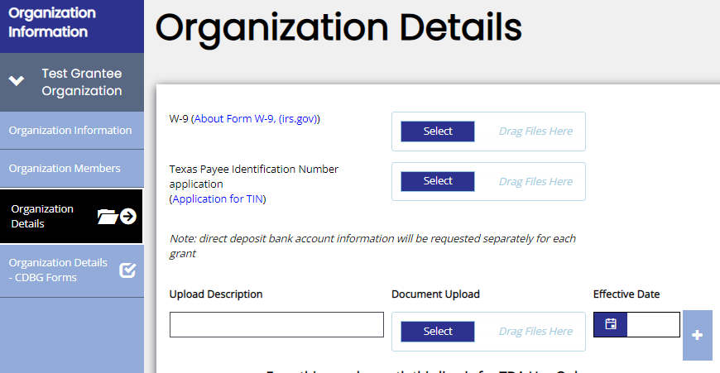
Group A - Organization Details
Organization Details (Banking and Financial Documentation )
Notes:
On the Organization Details page the Grant Recipient will upload the W-9 and the TIN forms.
As a reminder, the Organization page is for the city or county to use and must be maintained by city or county staff.
It is the responsibility of the city or county to maintain the members listed and their roles of responsibility.
Please note: Roles listed must match those outlined in the signatory resolution.
The consultant role does not and should not have access to Organizational pages in TDA-Go, however, you will need to communicate to your community as the Administrator that this information must be uploaded into the system by the organization.

Slide 7
Group A - Documentation
Organizational Details (Banking and Financial Documentation)
Required Forms:
W-9 Form
TIN Form
Direct Deposit (DD) Form
Direct Deposit Authorization Form (Form 74-176)
A separate 74-176 form must be completed for each grant award
Email form to CDBGReporting@TexasAgriculture.gov
Notes:
Information regarding the Banking and Financial Documentation guidance can be found under Chapter 2 of the Implementation Manual. There are three banking and financial documents needed: the W-9 form, the TIN form, and the Direct Deposit Form.
Regarding the Direct Deposit form: TDA does NOT currently request unredacted bank account information to be submitted within TDA-GO. Instead, email a completed form for each TxCDBG grant to CDBGReporting@TexasAgriculture.gov prior to executing the Grant Agreement and each time the banking information changes.
If the Grant Recipient declines to participate in direct deposit options, manually strike through Sections 3, 4, and 6 of the form and write in Warrant Requested.

Slide 8
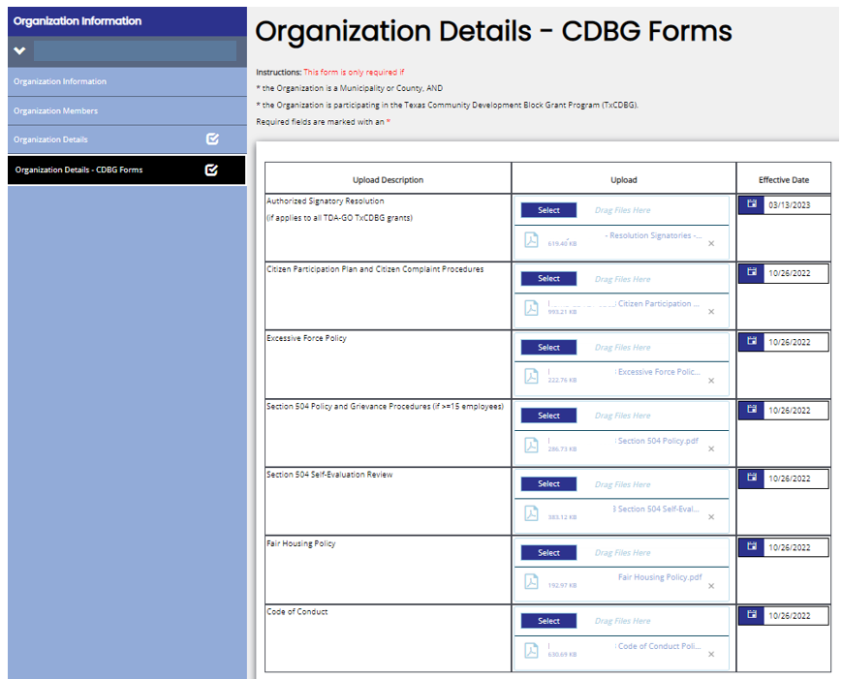
Group A - Documentation
Organization Details – CDBG Forms
City Name
Civil Rights Policies
Refer to form A100 and upload new form to Organization Details – CDBG Forms
Notes:
All grant recipients of CDBG funds are required to demonstrate compliance with all state and federal requirements to ensure equal opportunity and access to all benefits derived from the Texas CDBG Program.
On the Organization Details –CDBG Forms page the grant recipient will upload the following documents:
The authorized signatory resolution
The Citizen Participation Plan and Citizen Complaint Procedures
The Excessive Force Policy
The Section 504 Policy and Grievance Procedures
The Section 504 Self-Evaluation Review
The Fair Housing Policy and the
Code of Conduct
Please Note that the field for the Effective Date should be the date the policy was signed, not when the form was uploaded.
Let’s discussed these forms a little further.

Slide 9
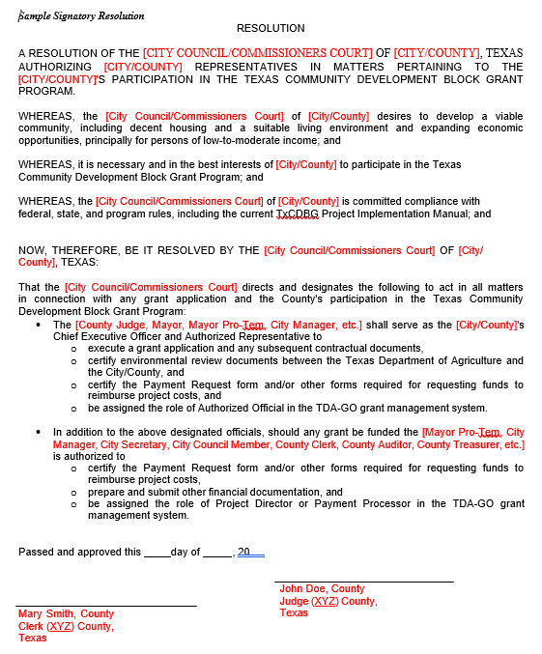
Group A - Documentation
Signatory Resolution
Refer to the new form A100 and upload new form to Organization Details – CDBG Forms
Notes:
The signatory resolution is the legal document that records the actions of the grant recipient officials on behalf of the community. When it comes to the Signatory Resolution, TDA recommends:
The use of form A100, this form provides the grant recipient roles with authorities for both the grant application and the awarded grant, and
There must be at least 2 signatory roles for payment requests per CDBG guidelines. If there is only one signatory, the resolution must be updated.
Every time the resolution is updated, the new document must be uploaded to the Organization Details –CDBG Forms page.
TDA also recommends the grant recipient use official roles such as Mayor, City Manager, City Administrator, and/or City Secretary, rather than the name of a person, to prevent a new resolution from being needed each time personnel changes.

Slide 10
Group A - Documentation
Organization Details – CDBG Forms
Civil Rights Policies
Citizen Participation Plan and Citizen Complaint Procedures
Excessive Force Policy
Section 504 Policy and Grievance Procedures
if >=15 employees
Section 504 Self-Evaluation Review
Fair Housing Policy
Code of Conduct
Notes:
The CDBG Civil Rights Policies Forms.
Let's park the car here a bit and talk about the importance of the forms.
The Citizen Participation Plan and Citizen Complaints Procedures:
The citizen participation plan is a pathway for all citizens to exercise their voice and influence decisions that affect their communities, neighborhoods and way of life. Because community involvement is a critical element of the CDBG program, the Grant Recipient must provide for and encourage citizen participation – especially low- and moderate-income persons that live in the community or are going to be served by the CDBG grant.
Excessive Force:
In accordance with Section 104(L) of the Housing and Community Development Act, as amended, Grant Recipients receiving CDBG funding must adopt an Excessive Force Policy that prohibits the use of excessive force against non-violent civil rights demonstrations.
The Section 504 Policy and Grievance Procedures (This is only required if the city or county has less than 15 employees):
Grant Recipients must develop complaint procedures for citizens to submit complaints and grievances that include a timely written response to complaints—within 15 days where practicable. This information must provide citizens with the address, phone number and times for submitting complaints and grievances, and provide timely written answers to written complaints and grievances.
The Section 504 Self-Evaluation Review:
The self-evaluation review includes an examination of policies and practices relative to the Section 504 compliance regulations. Any policies and practices that do not meet the Section 504 requirements must be modified, and corrective action taken to remedy any discrimination found. During the self-evaluation process, the Grant Recipient MUST consult with individuals with disabilities or organizations representing them. TDA is confident that each community has persons that should be consulted.
The Fair Housing Policy:
Section 808(e)(5) of the Fair Housing Act, requires that HUD programs and activities be administered in a manner affirmatively to further the policies of the Fair Housing Act. The Fair Housing Act provides for the protection of the following federally protected classes: Race, Disability, Color, Familial status, Religion, National origin, and Sex.
Grant Recipients must adopt (or affirm) a Fair Housing Policy by ordinance or resolution based on the requirements of the Fair Housing Act to affirmatively further fair housing choices for all seven protected classes.
The Code of Conduct: The Code of Conduct procedures are intended to serve as guidelines for the procurement of supplies, equipment, construction services and professional services for the CDBG Program. The regulations related to conflict of interest and nepotism may be found at the Texas Government Code, Texas Local Government Code, and the Uniform Grant Management Standards by Texas Comptroller.

Slide 11
Group A - Designated Personnel
Primary Administrative
Contact within TDA-GO!
Labor Standards Officer Designation (LSO)
Civil Rights Officer Designation (CRO)
Notes:
Now let’s move to the Grant Overview page:
This page contains fields that must be completed as a part of Group A and Civil Rights requirements, and if left incomplete, this will result in the performance report being returned for corrections.
On the top of the page, you will find fields for the Primary Administrative Contact within TDAGO, this will be the person responsible for administrating the grant and the person that TDA staff will contact when in need to address any issues, concerns or clarifications. The Primary Administrator will need to complete the contact's name, email and phone information fields and this person must be a Certified CDBG Administrator.
Below, you will find the fields for the Labor Standards and Civil Rights Officers. The Authorized Official must designate the person or persons that will oversee these portions of the agreement and ensure compliance.
This designation is made by listing the name of the LSO and CRO in the designated field and once complete, the Authorized Official must certify by checking the box and date.

Slide 12
TxCDBG Program
Group A and Materials and Services Reports

Slide 13
Group A - MSRs and Documents
Materials and Services Reports (MSRs)
The MSR must be submitted and accepted for each requested vendor or services provider.
The form can be updated several times throughout the grant agreement
MSR’s for administrative and engineering services are required even when Force Account.
Admin and Engineering (if applicable) MRS are Group A requirement.
Notes:
The Materials and Services Reports (MSRs) are forms in TDA-GO used to report the procurement of any goods or services throughout the grant agreement.
On this form you will complete the following information:
The MSR Preparation Information
The Pre-Selection Clearance
The MSR Award/Selection Information
And any Additional Documentation, if needed
The MSR must be submitted and accepted for each requested vendor or services provider. The Grant Recipient will update the MSR several times throughout the project.
MSR’s for administration and engineering services are required even in the case that force account has been approved for these services.
Group A requires Material and Services Reports (MSRs) for admin and engineering services.

Slide 14
Group A - MSRs and Documents
Materials and Services Reports
Materials and Services Main Form
Notes:
The Main Form, indicated on the left navigation pane with a red box, is where details are entered.
It is important to review all documents before uploading them to the Main Form page. Make sure to check for things like:
Are there signatures in all provided spaces on the documents?
Is the grant project number on the top of the document or in the description?
If the documents are scanned, are the text and/or numbers legible?
Simple checks like these prior to uploads will help avoid having your MSR sent back for corrections.
Only upload the forms listed on the page and nothing more.

Slide 15
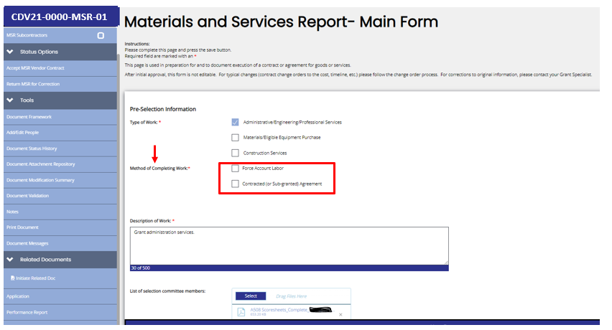
Group A - MSRs and Documents
MSR-01-A Administration
MSR-01-E Engineering
Notes:
Once on the Main Form screen, enter the “Type of Work Information” by checking one of the provided options.
TDA recommends using MSR 01 for administrative services and MSR-02 for engineering. For all new grant agreements, the Group A required MSR’s will be designated as MSR-01-A for administration and MSR-01-E for engineering. Please make sure you are using the correct MSR for the corresponding vendor.
Under the type of work section, there is a new area called “Method of Completing Work”. Here you will indicate the method of work by choosing either Force Account or Contracted.
Then, enter a description of the work in the box provided.

Slide 16
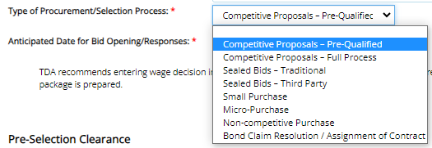
Group A - MSRs and Documents
Notes:
As we continue down the Main Form of the MSR, you will see an area to:
Upload a list of selection committee members
Indicate the type of Procurement used in the Selection Process
Provide the Anticipated Date for Bid Opening/Responses
The box labeled “Type of Procurement/Selection Process” lists different procurement methods. Guidance for each method is provide in the Implementation Manual, Chapter 5 Procurement Procedures.
Please note the Pre-Qualified Method was discontinued effective September 1, 2023. TDA will no longer solicit or post administrator and planner qualifications as part of a formal procurement process. TDA will make available the contact information of individuals and firms that have requested to be included as interested service providers.

Slide 17
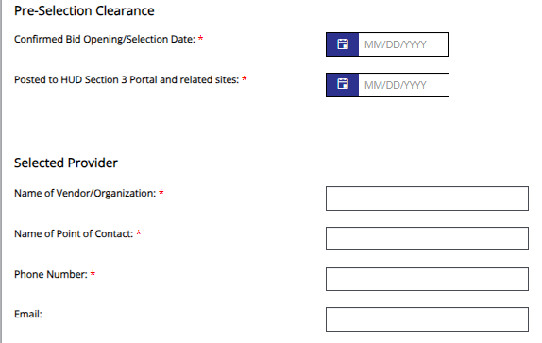
Group A - MSRs and Documents
Notes:
Enter Pre-Selection Clearance dates.
Once a vendor/provider is selected, enter their information under “Selected Provider”.

Slide 18
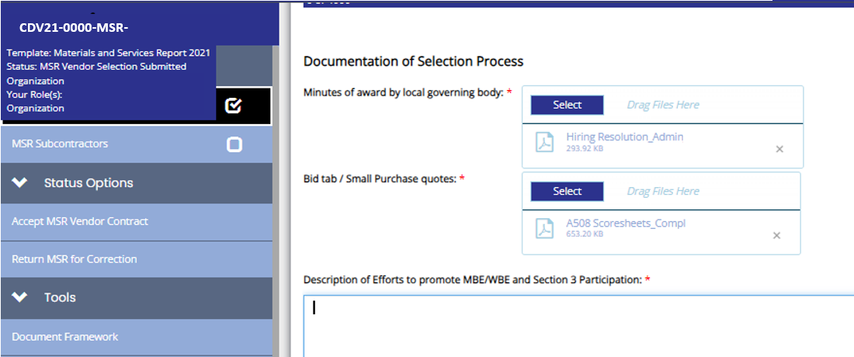
Group A - MSRs and Documents
Notes:
Under the Documentation of Selection Process, upload:
Minutes of award by local governing body
Scoresheets for Admin or Engineering depending on the MSR
Next, enter a description of Efforts to promote MBE/WBE and Section 3 Participation in the box provided.
Please note that the TDA MWBE email was removed from CDBG Implementation Manual in 2022. Unless procurement occurred before the 2022 Implementation Manual was published, this is no longer a valid option to show efforts to promote MBE/WBE.

Slide 19
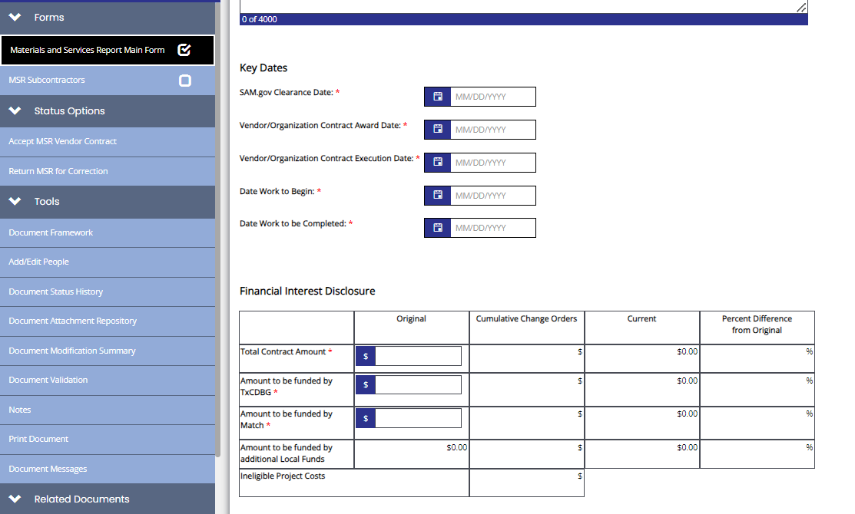
Group A - MSRs and Documents
Notes:
Complete the Key Dates section. The order of the fields should match the order of procurement and please note that the date for work to begin cannot precede the pre-agreement date and if there is no pre-agreement, the date for work to being cannot precede the grant agreement start date.
Engineering contracts must end by the grant agreement end date or sooner and administration contracts are allowed to extend to the Final Payment/PCR Due Date.
Then, enter contract amount, grant amount, and match amount into the “Original” column of the Financial Interest Disclosure Chart and click save. The local amount that exceeds the match will automatically be calculated for you.

Slide 20
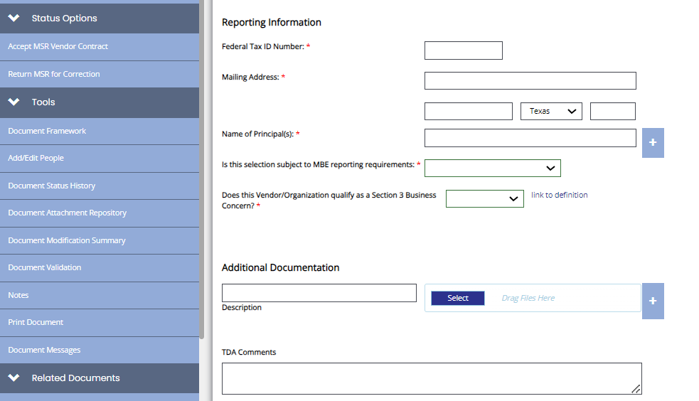
Group A - MSRs and Documents
Notes:
Finally, at the bottom of the page, enter the Reporting information for the selected vendor.
After all information has been entered click “Save”.
To submit the MSR, change the status to “Submit Vendor Selection” in the left-hand blue navigation menu under Status Options.

Slide 21
Group A - MSRs and Documents
Notes:
There are cases in which a change order is needed for administrative and engineering contracts. Whether it be an Amendment request to move funds between cost categories or additional services required due to an increased scope, a change order is required to document any increase or decrease in contract amount.
Instead of using the Form A505 as needed for construction, an addendum to the Administrative or Engineering contract and written justification from the Grant Recipient are required.
Please consult with your Grant Specialist if a change order for professional services is needed in combination with a budget amendment.

Slide 22
Group A - MSRs and Documents
Common Errors
Excluding the CDBG Grant number, contractor name, and awarded amount in the award minutes.
Entering dates for work to begin or end that precede the Pre-Agreement/start date or exceed the end date.
Incomplete/incorrect Financial Interest Disclosure.
Notes:
Materials and Service Reports common errors are …
TDA understands that in most cases, contracts for professional services are awarded before the grant start date and there may not be an agreement number at the time of award. By the time MSR’s are initiated in the TDA-GO system the agreement number has been generated and can be added into the margin or at the top of the minutes of award.
Please note that costs incurred outside of the grant agreement period will be ineligible with the exception of pre-agreement approved in the application stage. Any services procured that exceed the end date will not be eligible unless an amendment for contract period extension is submitted and approved.
The financial interest disclosure must include all awarded costs whether they be grant, match, or additional local funds and the amount to be funded by CDBG funds may not exceed the approved budget.

Slide 23
TxCDBG Program
Group A Performance Report and Documents

Slide 24
Group A – Performance Report
Required Uploads
Resolution adopting or reaffirming community policies (A1014)
Section 3 Service Area Map (Optional for 2023 Awards)
Fair Housing Activities
Required Non-discrimination Notices
Limited English Proficiency (LEP) plan – This plan must be specific to the location and the community or area served by the current project.
Notes:
You will be required to upload the:
resolution adopting or reaffirming community policies for civil rights
fair housing activities
non-discrimination notices
LEP information
The Section 3 map is no longer a required upload for agreements beginning in 2023 and moving forward but must be kept as a part of the local file. The link for the new HUD Neighborhood Service Area Definition Tool can be found on the Implementation Manual Website with the forms listed under Chapter 10.
Remember that ALL GPA documents, not just this report, must be complete before you click Save and Submit.

Slide 25
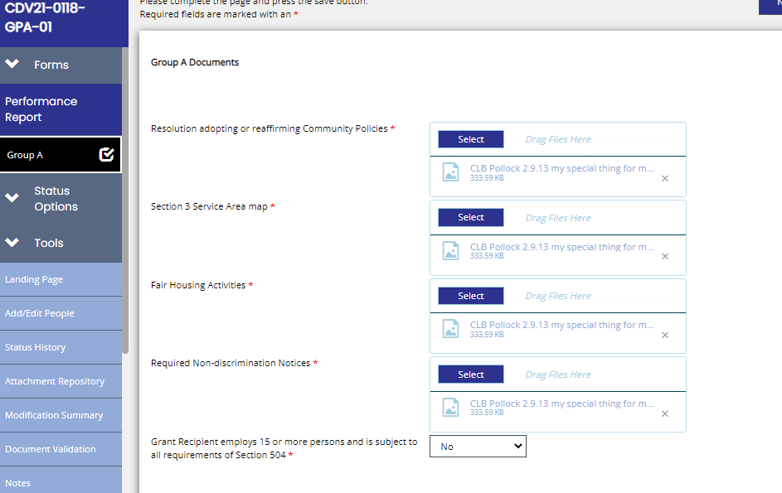
Group A – Performance Report
CDV21-0000-
GPA-01
Notes:
Once all the previous documents have been approved by TDA, open Performance Report – GPA and click on Group A shown in red.
The first required upload box is for the Resolution regarding Civil Rights.
TDA provides a sample resolution regarding Civil Rights. The A1014 form that can be located on the CDBG website forms page.
On this sample resolution form, all the required policies to be adopted/reaffirmed are listed and the grant recipient will be able to edit the areas in red to list the name of their organization accordingly.
You will see that each policy requirement is summarized to highlight the federal, HUD, or state regulation that corresponds to each form to be submitted as part of the civil rights requirement.
Please remember to replace all fields in red with your organization’s information; Name of City/County and agreement number.
For example:
Whereas, the City of Vernon, Texas (here in after referred to as “City”) has been awarded TxCDBG funding through a TxCDBG Grant No. CDV21-0001 from the Texas Department of Agriculture (hereinafter referred to as “TDA”);
Best practice is to name the file you are uploading to reflect the document name listed in TDA-Go. Based on LEP population, uploaded notices will need to be in English or both English and ‘other spoken language’.
Once these forms are uploaded you will have to select from the dropdown below to indicate whether your organization employs 15 or more persons and if the answer is yes, your organization will be subject to the additional Section 504 requirements.

Slide 26
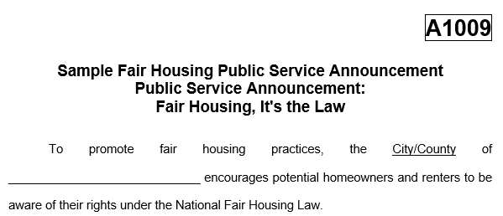
Group A – Performance Report
Fair Housing Activities
Fair Housing Activities – Form A1009
Notes:
Grant recipients are required adopt/affirm a Fair Housing Policy by ordinance or resolution and complete an addition activity to affirmatively further fair housing. This can include the declaration of Fair Housing Month by proclamation/resolution in combination with a second activity or a fair housing public service announcement posted or published in the local newspaper.
HUD’s fair housing website contains an abundance of information and tools for organizations to use in conducting their fair housing activities.
Eligible expenses associated with fair housing activities may count towards the local match requirement or submitted for reimbursement to be paid by CDBG as a part of general administration.
When submitting fair housing activities in the form of a newspaper tearsheet, please keep in mind that the name of the publication, publication date, and page number must be visible. If submitting a publication snippet or photo of public posting a signed affidavit is required.

Slide 27
Group A – Performance Report
Required Notices
Public Notices may be given in one of three ways:
Publish the notice in a newspaper of general circulation.
Post the notice in at least two public places accessible to the general public at the time of the posting including the courthouse/city hall and a location within the target area (if applicable).
Post the notice in one public place accessible to the general public at the time of the posting, such as the courthouse/city hall, and post on Grant Recipient’s website.
Notes:
Public Notice may be given in one of three ways:
Publish the notice in a newspaper of general circulation.
Post the notice in at least two public places accessible to the general public at the time of the posting including the courthouse/city hall and a location within the target area (if applicable).
Post the notice in one public place accessible to the general public at the time of the posting, such as the courthouse/city hall, and post on Grant Recipient’s website.

Slide 28
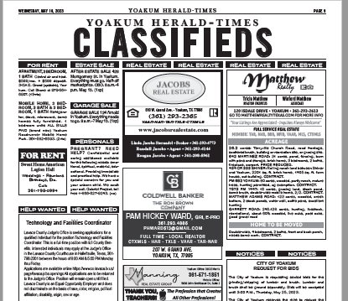
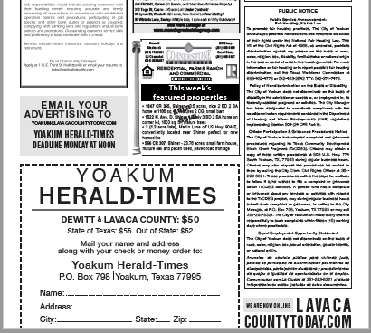
Group A – Performance Report
Required Notices
The full newspaper tear sheet or a photocopy of the notice and a publisher’s affidavit must be kept with the Grant Recipient’s local file for the public, TDA monitors, and other state or federal inspectors.
Tear sheet Example
Notes:
Documentation of the Notice continued
The full newspaper tear sheet or a photocopy of the notice and a publisher’s affidavit must be kept with the Grant Recipient’s local file for the public, TDA monitors, and other state or federal inspectors.

Slide 29
Group A – Performance Report
Required Notices
Documentation of the Public Notice Continued
Website Notices – Screen shots of the notice, with the date visible, must be retained as documentation of the posting.
Posted Notices – Legible photographs showing the location of the posting are required and must be supported by affidavit, see Affidavit of Posting - Citizen Participation Public Hearing (Form A101).
Notes:
Website Notices
Screen shots of the notice, with the date visible, must be retained as documentation of the posting.
Posted Notices
Legible photographs showing the location of the posting are required.
Must be supported by affidavit, see Affidavit of Posting - Citizen Participation Public Hearing (Form A101).

Slide 30
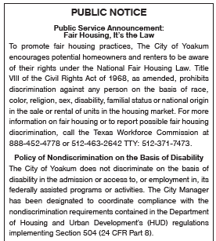
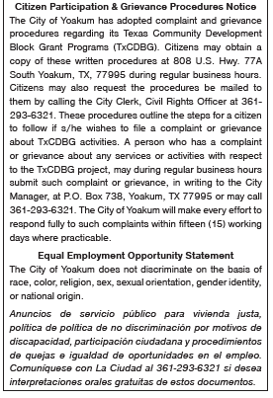
Group A Documents
Required Non-discrimination Notices
Notes:
Non-discrimination Notices are reviewed for compliance with the city or county’s Limited English Proficiency policy.

Slide 31
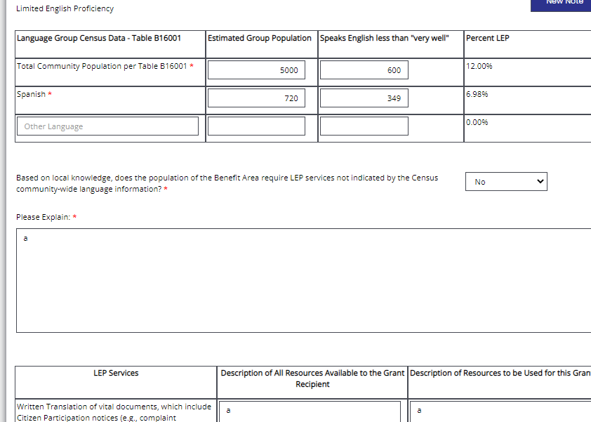
Group A – Performance Report
Limited English Proficiency
Notes:
LEP Census Data Chart
The LEP services are required by HUD for individuals who do not speak English as their first language and who may be limited in their abilities to read, write, or understand English. If the population you are serving is primarily made of up non-English speaking individuals, they need to have the same access to fair housing information.

Slide 32
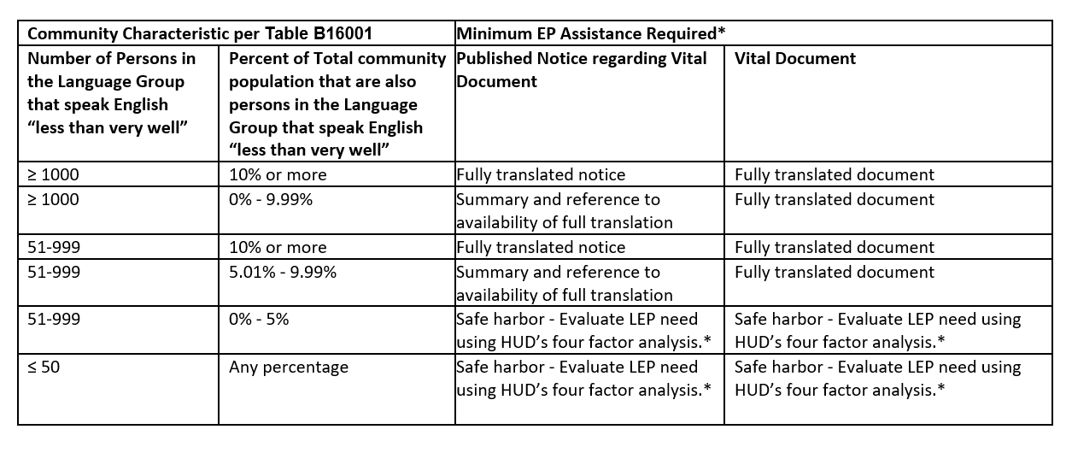
Group A – Performance Report
Limited English Proficiency
Purpose of LEP Services
Notes:
Recipients are required to take reasonable steps to ensure meaningful access to LEP persons and as a starting point, may conduct an individualized assessment that balances the following four factors:
· The number or proportion of LEP persons served or encountered in the eligible service population including those who would be served or encountered by the recipient if they received adequate education, outreach, and sufficient language services.
· The frequency with which LEP persons come into contact with the program
· The nature and importance of the program, activity, or service provided by the program
· The resources available and costs to the recipient.
LEP Safe Harbor was adopted by HUD for translation of written materials and the Guidance identifies actions that will be considered strong evidence of compliance with Title VI obligations. The use of "safe harbor" means the provision of written language services when marketing to the eligible LEP population within the market area.
In many cases, it may be determined that no services are required if the population does not meet the threshold, however, populations under 5% are subject to Safe Harbor evaluation and based on the four-factor analysis should be provided the translation services necessary.
For example, if there is a small population of Arabic speaking persons within the total community that only equals 0.64 %, the Safe Harbor evaluation using the four-factor analysis should then be used to determine if translation services are needed. A simple “no” in this case does not prove that reasonable efforts were made to accommodate this population and would not provide evidence of compliance. In the case a complaint is made, HUD will require the recipient to take steps to correct any non-compliance and if unresolved could result in the termination of financial assistance.

Slide 33
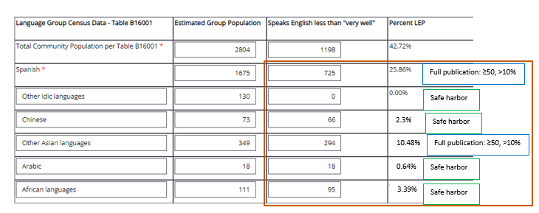
Group A – Performance Report
Limited English Proficiency
LEP Table 1
Notes:
In the first table for the LEP requirement you will see fields to fill out to help determine if your population requires LEP services. You must enter all languages included in the census data for your benefit area.
Spanish is the default language listed in the table, but you may add additional or alternative languages by clicking the plus sign at the bottom right hand of this table.
If additional languages are added and the percentage of LEP is not auto populated, please enter the percentages in the box below.
After these criteria are entered you will select yes or no regarding whether your population meets the LEP requirements and how the population of the benefit area was determined to meet or not meet these requirements.

Slide 34
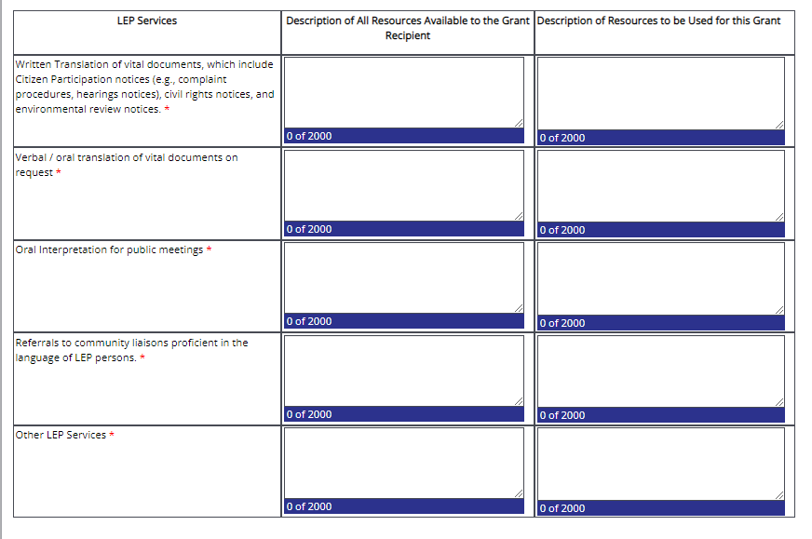
Group A – Performance Report
Limited English Proficiency
LEP Table 2
Notes:
The second LEP table will need to include a description of the resources available to your organization as well as which of the resources will be used for this grant agreement.
The services include written translation of vital documents, verbal and oral translation of vital documents upon request, oral translation for public meetings, and referral to a community liaison proficient in the LEP language.
There is an additional field available to enter any other LEP services your organization wishes to provide.
Please note that this second table must be filled in even if you do not meet the LEP percentage requirement. Your organization must demonstrate that these LEP services would be available if the LEP threshold was met.

Slide 35
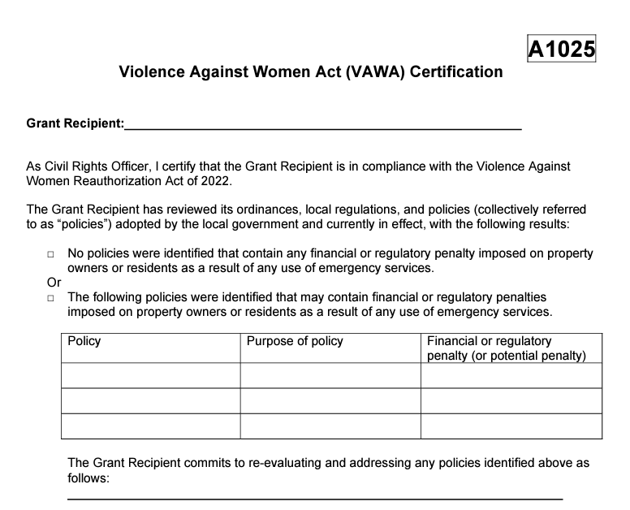
Pre-Construction
Violence Against Women Act (VAWA) Certification
VAWA – Form A1025
Notes:
A new addition to the Group A Requirements for is the Violence Against Women Act (VAWA) Certification form A1025. The Violence Against Women Act (VAWA) Reauthorization Act of 2022, which became effective October 1, 2022, includes a new requirement for Grant Recipients to support an individual’s, including survivors of violence, right to seek law enforcement or emergency assistance.
Here is a what TDA’s form A1025 looks like. Once completed by the Civil Rights Officer you will upload this form to the Grant Overview page under the Special Conditions section of the page.
Please note that Grant Specialists do not receive an automated notification when this form is uploaded. You will need to contact your Grant Specialist to let them know when this is completed so it can be reviewed for approval prior to the submission/approval of the Group A Performance Report.

Slide 36
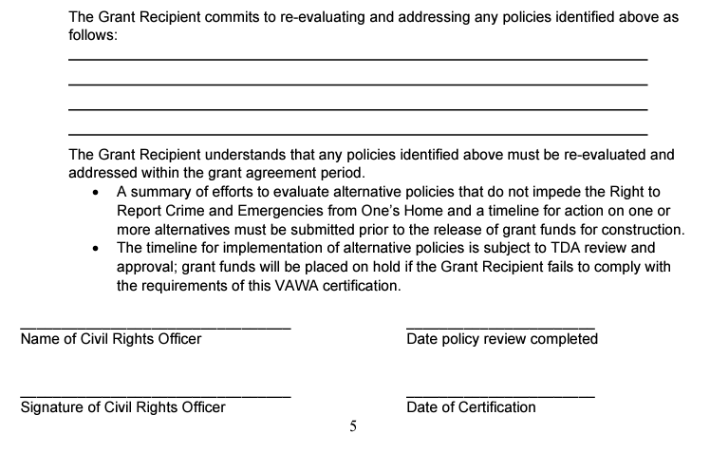
Pre-Construction
Violence Against Women Act (VAWA) Certification
Make sure the person who signs the form is the designated CRO listed on the Grant Overview page.
Notes:
TxCDBG grants awarded on or after the effective date will be required to:
1. “Report any of their laws or policies, or, as applicable, the laws or policies adopted by subgrantees, that impose penalties on landlords, homeowners, tenants, residents, occupants, guests, or housing applicants based on requests for law enforcement or emergency assistance or based on criminal activity that occurred at a property; and
2. Certify that they are in compliance…” with the VAWA requirements.
As of the publication of this Manual, HUD has not provided guidance for this review and certification. Once issued, TDA will provide a Policy Issuance and sample certification.

Slide 37
Group A – Performance Report
Performance Report
Common Errors Are …
Designations for Civil Rights Officer and Labor Standards Officer are incomplete or not certified.
Organization documents are not uploaded or incomplete.
The VAWA Form 1025 is not uploaded, not filled out completely, or is not certified by the designated CRO.
The Direct Deposit form is not submitted or is filled out incorrectly.
Notes:
Performance Report GPA Common Errors Are …
The CRO and LSO designations are located on the Grant Overview page and are required as a part of Group A. The name is the individual appointed should be entered and may be listed with the appointed role but the role by itself will not be accepted.
The Organization documents are not uploaded or are incomplete. Please communicate with the Grant Recipient to ensure that they are completing this correctly. You may contact your Grant Specialist to verify if the Organization documents are uploaded and correct prior to submitting Group A.
The VAWA form has specific fields that need to be completed in addition to the required certification by the designated CRO. Please make sure that the correct individual is certifying the form and that the required fields have been checked/populated.
The Direct Deposit forms must be submitted to CDBG Reporting for agreements awarded prior to 2023 and will otherwise be uploaded to the FMS performance report.

Slide 38
Questions/Comments

